Slide 1
Optimal Demand Response and Power Flow
Steven Low
Computing + Math Sciences
Electrical Engineering
Caltech
March 2012
Notes:
Economic Dispatch in Power Networks with Storage
March 10-12, 2010: Workshop on Distributed Decisions via Games and Price Mechanisms, Lund University, Sweden (Anders Rantzer)
Aug 24, 2010: Lund University, Sweden
Sept 28, 2010: Complexity workshop, Caltech, CA (John Doyle)
Oct 5, 2010: Southern California Smart Grid Symposium
Oct 25, 2010: DIMACS workshop on Algorithmic Decision Theory for Smart Grids
Nov 1, 2010: Energy Workshop: A System Approach Toward Green Energy Production and Adaptive Power Distribution. Cal State University, Long Beach, CA (Prof Henry Yeh)
Nov 11, 2010: Southern California Network Economics & Game Theory Workshop, UCLA (Prof Mihaela van der Schaar)
Nov 16, 2010: Caltech Lunch Bunch Seminar
Dec 13, 2010: ARPA-E GENI (Smart Grid) Workshop
Jan 2011: KACST Workshop on Smart Grid, Riyadh, Saudi Arabia
Feb 7, 2011: Workshop on Information Theory & Application, UCSD, CA
Feb 18-29, 2011: NSCU-SRI Workshop on Cyber-Physical Applications in Smart Power Systems, North Carolina State University, Raleigh, NC

Slide 2
Motivations Big picture

Slide 3
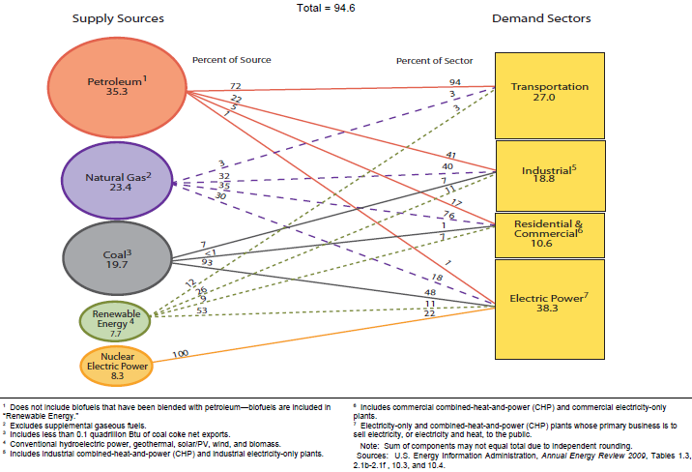
US Primary Energy Flow 2009
quadrillion BTU
8%

Slide 4
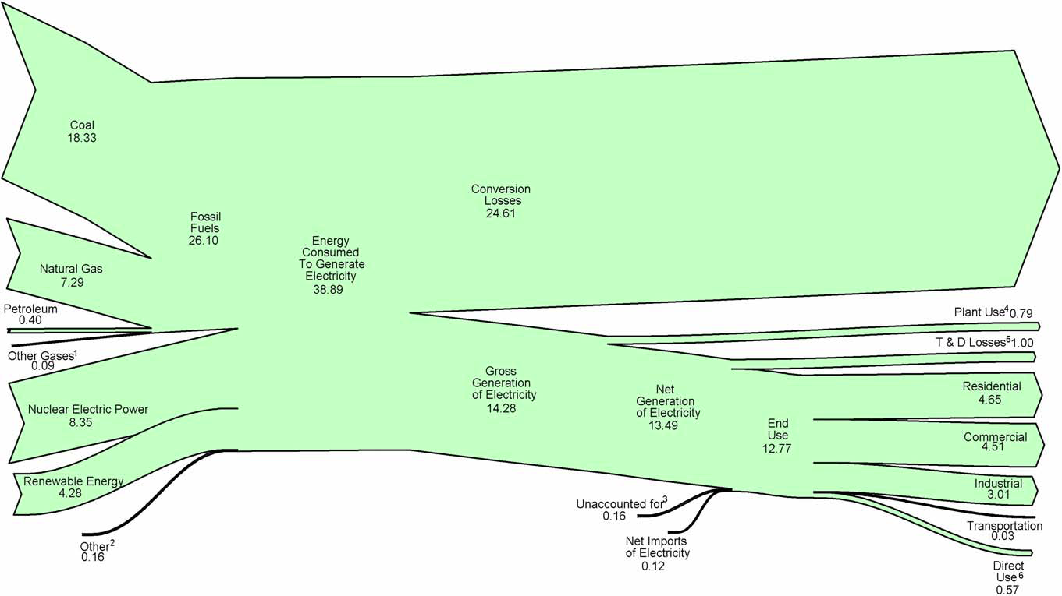
US electricity flow 2009
quadrillion Btu
Conversion loss: 63%
Fossil : 67%
Plant use: 2%
T&D losses: 2.6%
Gross gen: 37%
Nuclear: 22%
Renewable: 11%
US total energy use: 94.6 quads
For electricity gen: 41%
End use: 33%
Source: EIA Annual Energy Review 2009

Slide 5
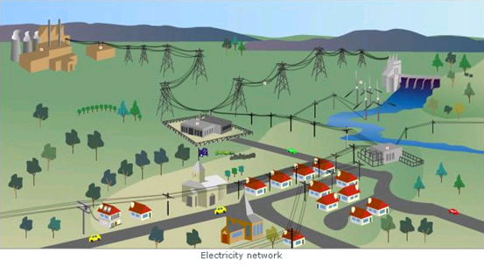
Where does electricity come from
generator
generator
transmission
Transcos
substation
Transmission:
enerator to
distribution
Transmission: from generator to substation, long distance, high voltage
Distribution: from substation to customer, shorter distance, lower voltage

Slide 6
Global trends
1 Proliferation renewables
Driven by sustainability
Enabled by policy and investment

Slide 7
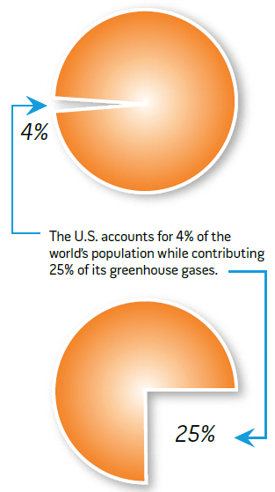
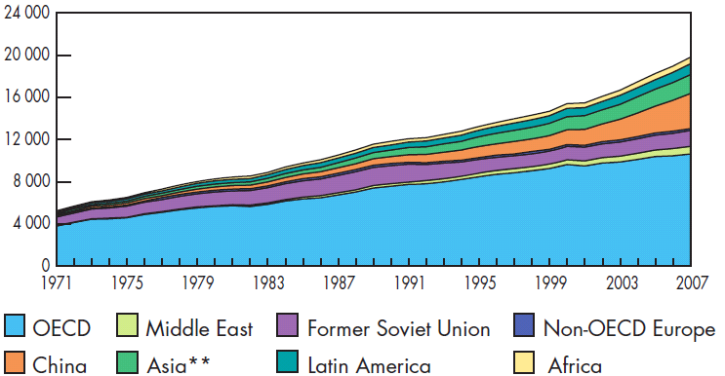
Sustainability challenge
Electricity generation 1971-2007
2007:
19,800 TWh
1973:
6,100 TWh
In 2009, 1.5B people
have no electricity
US CO₂ emission
Elect generation: 40%
Transportation: 20%
Sources: International Energy Agency, 2009
DoE, Smart Grid Intro, 2008

Slide 8
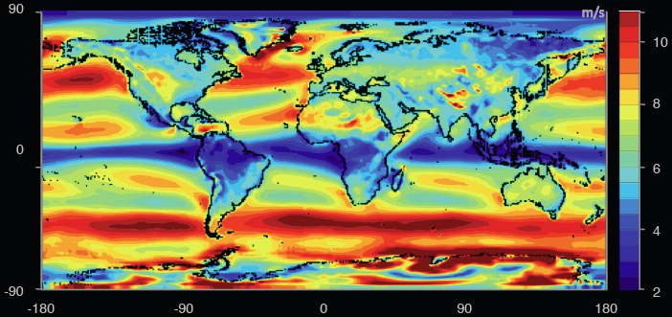
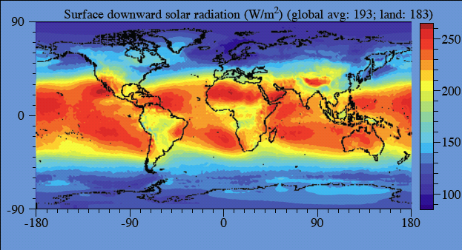
Worldwide
energy demand:
16 TW
electricity demand:
2.2 TW
wind capacity (2009):
159 GW
grid-tied PV capacity (2009):
21 GW
Wind power over land (exc. Antartica)
70 – 170 TW
Source: Renewable Energy
Global Status Report, 2010
Source: M. Jacobson, 2011
Solar power over land
340 TW
Notes:
World wind speed at 100m:
All wind worldwide: 1,700 TW
All wind over land in high-wind areas outside Antartica: 70 – 170 TW
World power (all energy) demand in 2030: 16.9 TW
World surface solar
All solar worldwide: 6,500 TW
All solar over land in high-solar locations: 340 TW
Source: Renewable Energy Global Status Report, Sept 2010:
2009 grid-tied solar PV capacity increase
The world added 7GW of grid-connected PV capacity, to a total of 21 GW
Germany: +3.8 GW to a total of 9.8 GW
Spain: +70MW to a total of 3.4 GW (Govt subsidy expired!)
US: +470MW to a total of 1 GW (CA ~half of increase)
Off-grid capacity: 4 GW
2009 wind capacity increase
Wind power increased the most among all renewables, by 38 GW to a total of 159 GW
US: +10 GW to a total of 35 GW
China: +13.8 GW to a total of 25.8 GW
Germany: +1.9GW to a total of 25.8 GW

Slide 9
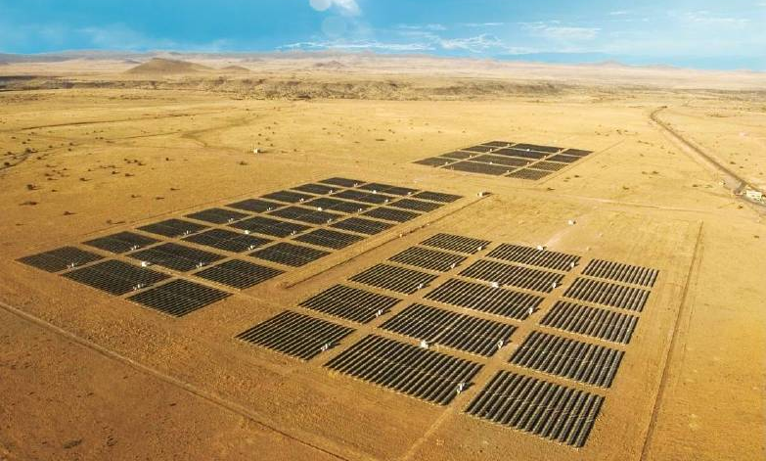
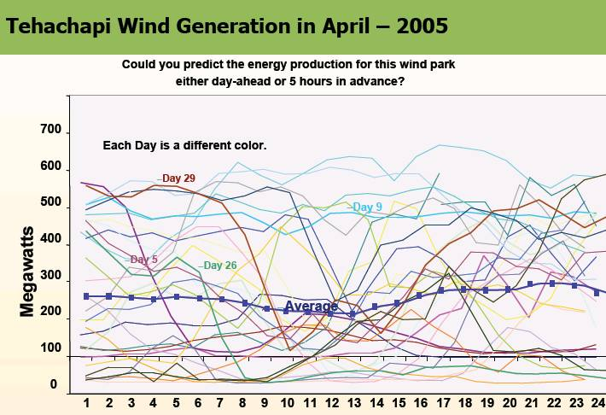
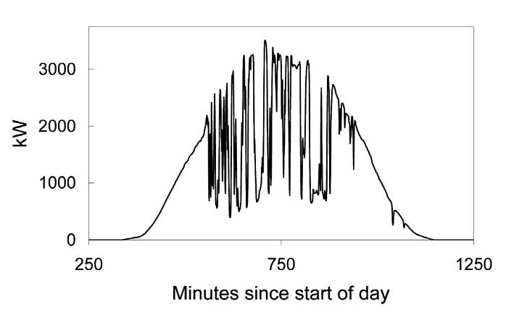
Uncertainty
High Levels of Wind and Solar PV Will Present an Operating Challenge!
Source: Rosa Yang, EPRI

Slide 10
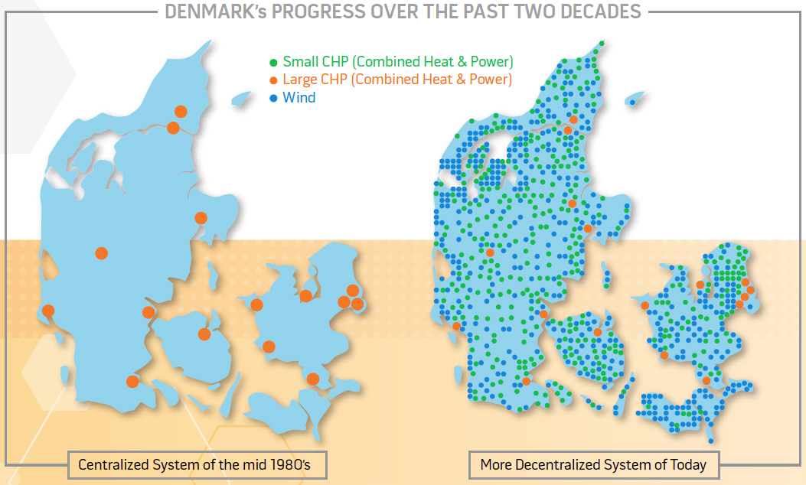
Global trends
1 Proliferation of renewables
Driven by sustainability
Enabled by policy and investment
2 Migration to distributed arch
2-3x generation efficiency
Relief demand on grid capacity

Slide 11
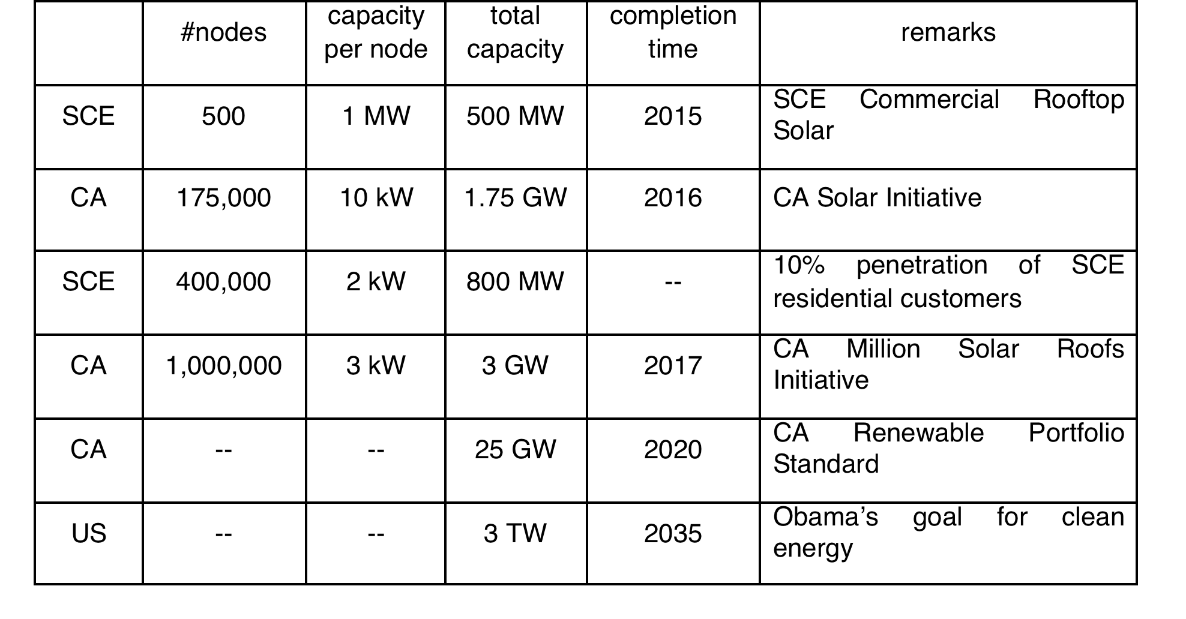
Large active network of DER
DER: PVs, wind turbines, batteries, EVs, DR loads

Slide 12
Large active network of DER
Millions of active endpoints introducing rapid large
random fluctuations
in supply and demand
DER: PVs, wind turbines, EVs, batteries, DR loads

Slide 13
Implications
Current control paradigm works well today
Low uncertainty, few active assets to control
Centralized, open-loop, human-in-loop, worst-case preventive
Schedule supplies to match loads
Future needs
Fast computation to cope with rapid, random, large fluctuations in supply, demand, voltage, freq
Simple algorithms to scale to large networks of active DER
Real-time data for adaptive control, e.g. real-time DR

Slide 14






Outline
Optimal demand response
With L. Chen, L. Jiang, N. Li
Optimal power flow
With S. Bose, M. Chandy, C. Clarke, M. Farivar, D. Gayme, J. Lavaei

Slide 15
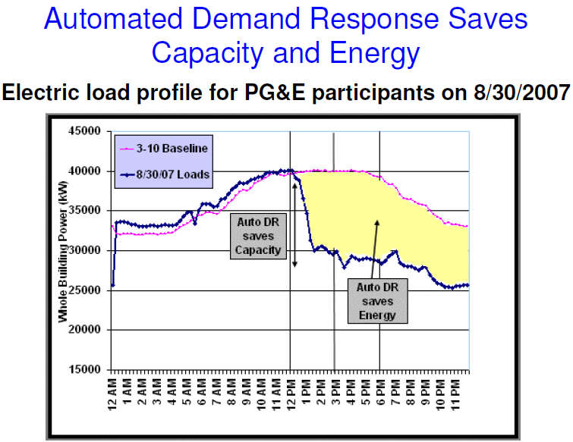
Source: Steven Chu, GridWeek 2009

Slide 16
Optimal demand response
Model
Results
Uncorrelated demand: distributed alg
Correlated demand: distributed alg
Impact of uncertainty
Some refs:
Kirschen 2003, S. Borenstein 2005, Smith et al 2007
Caramanis & Foster 2010, 2011
Varaiya et al 2011
Ilic et al 2011

Slide 17
Optimal demand response
Model
Results
Uncorrelated demand: distributed alg
Correlated demand: distributed alg
Impact of uncertainty
L Chen, N. Li, L. Jiang and S. H. Low, Optimal demand response. In Control & Optimization Theory of Electric Smart Grids, Springer 2011
L. Jiang and S. H. Low, CDC 2011, Allerton 2011

Slide 18
Features to capture
Wholesale markets
Day ahead, real-time balancing
Renewable generation
Non-dispatchable
Demand response
Real-time control (through pricing)
day ahead
balancing
renewable
utility
utility
users
users

Slide 19
Model: user
Each user has 1 appliance (wlog)
Attains utility u_{i}(x_{i}(t)) when consumes x_{i}(t)
Demand at t:

Slide 20
Model: LSE (load serving entity)
capacity
Power procurement
Day-ahead power:
Control, decided a day ahead
Renewable power:
Random variable, realized in real-time
Real-time balancing power:
energy

Slide 21
Model: LSE (load serving entity)
capacity
Power procurement
Day-ahead power:
Control, decided a day ahead
Renewable power:
Random variable, realized in real-time
Real-time balancing power:
energy

Slide 22
Model: LSE (load serving entity)
capacity
Power procurement
Day-ahead power:
Control, decided a day ahead
Renewable power:
Random variable, realized in real-time
Real-time balancing power:
energy

Slide 23
Model: LSE (load serving entity)
capacity
Power procurement
Day-ahead power:
Control, decided a day ahead
Renewable power:
Random variable, realized in real-time
Real-time balancing power:
energy
Use as much renewable as possible
Optimally provision day-ahead power
Buy sufficient real-time power to balance demand

Slide 24
Simplifying assumption
No network constraints

Slide 25
Objective
Day-ahead decision
How much power should LSE buy from day-ahead market?
Real-time decision (at t-)
How much should users consume, given realization of wind power and ?
How to compute these decisions distributively?
How does closed-loop system behave ?
t – 24hrs
t-
available info:
decision:

Slide 26
Objective
Real-time (at t-)
Given and realizations of , choose optimal to max social welfare
Day-ahead
Choose optimal that maximizes expected optimal social welfare
t – 24hrs
t-
available info:
decision:

Slide 27
Optimal demand response
Model
Results
Uncorrelated demand: distributed alg
Correlated demand: distributed alg
Impact of uncertainty

Slide 28
Uncorrelated demand: T=1
Each user has 1 appliance (wlog)
Attains utility u_{i}(x_{i}(t)) when consumes x_{i}(t)
Demand at t:
drop t for this case

Slide 29
Welfare function
Supply cost
Welfare function (random)
excess demand
user utility
supply cost

Slide 30
Welfare function
Supply cost
Welfare function (random)
excess demand
user utility
supply cost

Slide 31
Optimal operation
Welfare function (random)
Optimal real-time demand response
Optimal day-ahead procurement
given realization
of
Overall problem:

Slide 32
Optimal operation
Welfare function (random)
Optimal real-time demand response
Optimal day-ahead procurement
given realization
of
Overall problem:

Slide 33
Optimal operation
Welfare function (random)
Optimal real-time demand response
Optimal day-ahead procurement
given realization
of
Overall problem:

Slide 34
Real-time DR vs scheduling
Real-time DR:
Scheduling:
Theorem
Under appropriate assumptions:
benefit increases with
uncertainty
marginal real-time cost

Slide 35
Algorithm 1 (real-time DR)
real-time DR
Active user i computes
Optimal consumption
LSE computes
Real-time “price”
Optimal day-ahead energy to use
Optimal real-time balancing energy

Slide 36
Algorithm 1 (real-time DR)
Active user i :
inc if marginal utility > real-time price
LSE :
inc if total demand > total supply
Decentralized
Iterative computation at t-

Slide 37
Algorithm 1 (real-time DR)
Theorem: Algorithm 1
Socially optimal
Converges to welfare-maximizing DR
Real-time price aligns marginal cost of supply with individual marginal utility
Incentive compatible
max i’s surplus given price

Slide 38
Algorithm 2 (day-ahead procurement)
Optimal day-ahead procurement
LSE:
calculated from Monte Carlo simulation of Alg 1
(stochastic approximation)

Slide 39
Algorithm 2 (day-ahead procurement)
Theorem
Algorithm 2 converges a.s. to optimal
for appropriate stepsize

Slide 40
Optimal demand response
Model
Results
Uncorrelated demand: distributed alg
Correlated demand: distributed alg
Impact of uncertainty

Slide 41
Impact of renewable on welfare
Renewable power:
mean
zero-mean RV
Optimal welfare of (1+T)-period DP

Slide 42
Impact of renewable on welfare
Theorem
increases in a, decreases in b
increases in s (plant size)

Slide 43
With ramp rate costs
Day-ahead ramp cost
Real-time ramp cost
Social welfare
Theorem
increases in a, decreases in b
increases in s (plant size)

Slide 44
Outline
Optimal demand response
With L. Chen, L. Jiang, N. Li
Optimal power flow
With S. Bose, M. Chandy, C. Clarke, M. Farivar, D. Gayme, J. Lavaei

Slide 45
Optimal power flow (OPF)
OPF is solved routinely to determine
How much power to generate where
Market operation & pricing
Parameter setting, e.g. taps, VARs
Non-convex and hard to solve
Huge literature since 1962
In practice, operators often use heuristics to find a feasible operating point
Or solve DC power flow (LP)

Slide 46
Optimal power flow (OPF)
Problem formulation
Carpentier 1962
Computational techniques:
Dommel & Tinney 1968
Surveys: Huneault et al 1991, Momoh et al 2001, Pandya et al 2008
Bus injection model (SDP formulation):
Bai et al 2008, 2009, Lavaei et al 2010
Bose et al 2011, Sojoudi et al 2011, Zhang et al 2011
Lesieutre et al 2011
Branch flow model
Baran & Wu 1989, Chiang & Baran 1990, Farivar et al 2011

Slide 47
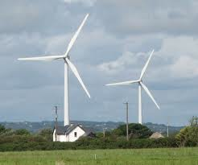
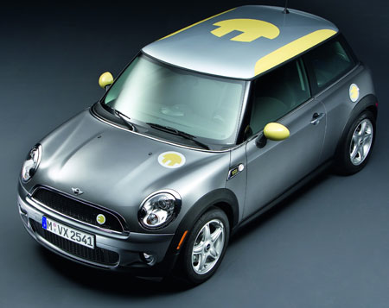
Models
i
j
k
branch
flow
bus
injection
i
j
k

Slide 48
Models: Kirchhoff’s law
linear relation:

Slide 49
Outline: OPF
SDP relaxation
Bus injection model
Conic relaxation
Branch flow model
Application

Slide 50
Bus injection model
Nodes i and j are linked with an admittance
Kirchhoff's Law:

Slide 51
Classical OPF
Generation cost
Generation power constraints
Voltage magnitude constraints
Kirchhoff law
Power balance

Slide 52
Classical OPF
In terms of V:
Key observation [Bai et al 2008]:
OPF = rank constrained SDP

Slide 53
Classical OPF
convex relaxation: SDP

Slide 54
Semi-definite relaxation
Non-convex QCQP
Rank-constrained SDP
Relax the rank constraint and solve the SDP
Does the optimal solution satisfy the rank-constraint?
yes
no
We are done!
Solution may not
be meaningful

Slide 55
SDP relaxation of OPF
Lagrange
multipliers

Slide 56
Sufficient condition
Theorem
If has rank n-1 then
has rank 1, SDP relaxation is exact
Duality gap is zero
A globally optimal can be recovered
All IEEE test systems (essentially) satisfy the condition!
J. Lavaei and S. H. Low: Zero duality gap in optimal power flow problem.
Allerton 2010, TPS 2011

Slide 57
OPF over radial networks
Suppose
tree (radial) network
no lower bounds on power injections
Theorem
always has rank n-1
always has rank 1 (exact relaxation)
OPF always has zero duality gap
Globally optimal solvable efficiently
S. Bose, D. Gayme, S. H. Low and M. Chandy, OPF over tree networks.
Allerton 2011

Slide 58
OPF over radial networks
Suppose
tree (radial) network
no lower bounds on power injections
Theorem
always has rank n-1
always has rank 1 (exact relaxation)
OPF always has zero duality gap
Globally optimal solvable efficiently
Also: B. Zhang and D. Tse, Allerton 2011
S. Sojoudi and J. Lavaei, submitted 2011

Slide 59
QCQP over tree
QCQP
graph of QCQP
QCQP over tree

Slide 60
QCQP over tree
QCQP
Semidefinite relaxation

Slide 61
QCQP over tree
QCQP
Key assumption
Theorem
Semidefinite relaxation is exact for
QCQP over tree
S. Bose, D. Gayme, S. H. Low and M. Chandy, submitted March 2012

Slide 62
OPF over radial networks
“no lower bounds”
removes these
Theorem
always has rank n-1
always has rank 1 (exact relaxation)
OPF always has zero duality gap
Globally optimal solvable efficiently

Slide 63
OPF over radial networks
bounds on constraints
remove these
Theorem
always has rank n-1
always has rank 1 (exact relaxation)
OPF always has zero duality gap
Globally optimal solvable efficiently

Slide 64
Outline: OPF
SDP relaxation
Bus injection model
Conic relaxation
Branch flow model
Application

Slide 65
Branch flow model
i
j
k
branch
power
Kirchhoff’s Law:
line
loss
load - gen

Slide 66
Branch flow model
i
j
k
branch
power
Kirchhoff’s Law:
Ohm’s Law:

Slide 67
OPF using branch flow model
real power loss
CVR (conservation
voltage reduction)
Kirchoff’s Law:
Ohm’s Law:

Slide 68
OPF using branch flow model
Kirchhoff’s Law:
Ohm’s Law:

Slide 69
OPF using branch flow model
demands
Kirchhoff’s Law:
Ohm’s Law:

Slide 70
OPF using branch flow model
generation
VAR control
Kirchhoff’s Law:
Ohm’s Law:

Slide 71
Solution strategy
OPF
nonconvex
inverse
projection
for tree
angle
relaxation
OPF-ar
nonconvex
conic
relaxation
exact
relaxation
OPF-cr
convex

Slide 72
Angle relaxation
Kirchhoff’s Law:
Ohm’s Law:
Angles of I_{ij} , V_{i} eliminated !
Points relaxed to circles
Baran and Wu 1989
for radial networks

Slide 73
Angle relaxation
Baran and Wu 1989
for radial networks

Slide 74
OPF-ar
Linear objective
Linear constraints
Quadratic equality

Slide 75
OPF-cr
Quadratic inequality

Slide 76
OPF over radial networks
Theorem
Both relaxation steps are exact
OPF-cr is convex and exact
Phase angles can be uniquely determined
OPF-ar has zero duality gap
M. Farivar, C. Clarke, S. H. Low and M. Chandy, Inverter VAR control for distribution systems with renewables. SmartGridComm 2011

Slide 77
What about mesh networks ??
M. Farivar and S. H. Low, submitted March 2012

Slide 78
Solution strategy
OPF
nonconvex
inverse
projection
for tree
angle
relaxation
??
OPF-ar
nonconvex
conic
relaxation
exact
relaxation
OPF-cr
convex

Slide 79
OPF using branch flow model
Kirchoff’s Law:
Ohm’s Law:

Slide 80
Convexification of mesh networks
OPF
OPF-ar
OPF-ps
Theorem
Need phase shifters only
outside spanning tree

Slide 81
Key message
Radial networks computationally simple
Exploit tree graph & convex relaxation
Real-time scalable control promising
Mesh networks can be convexified
Design for simplicity
Need few phase shifters (sparse topology)

Slide 82
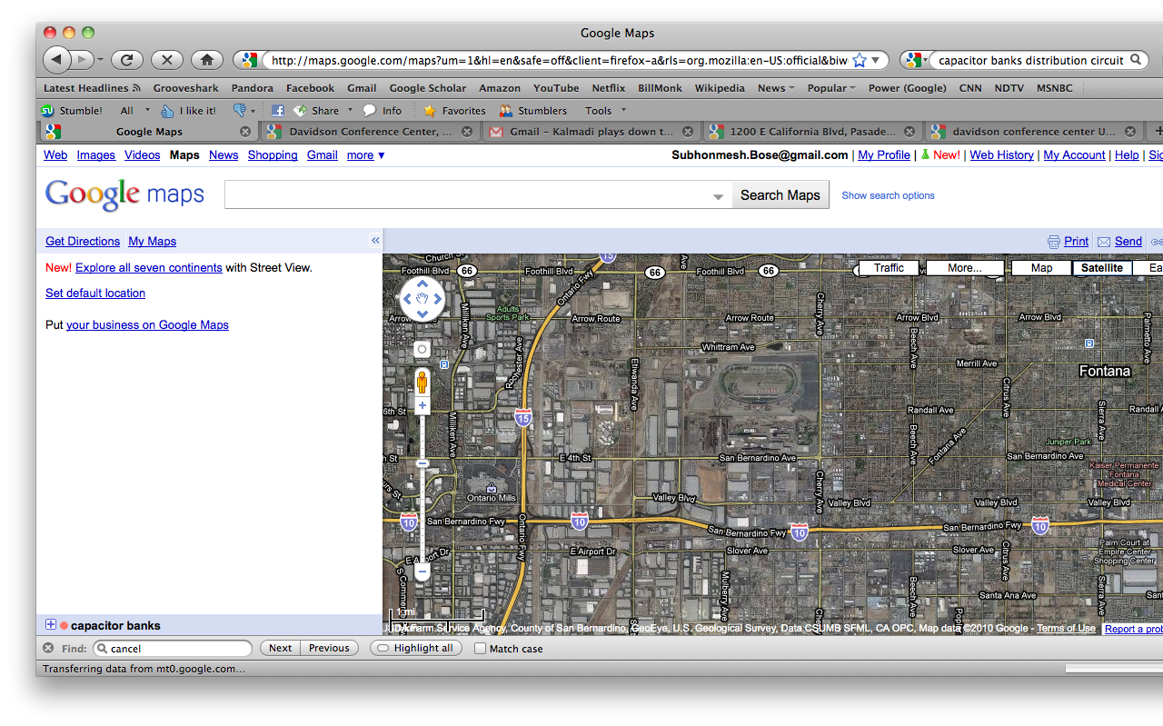
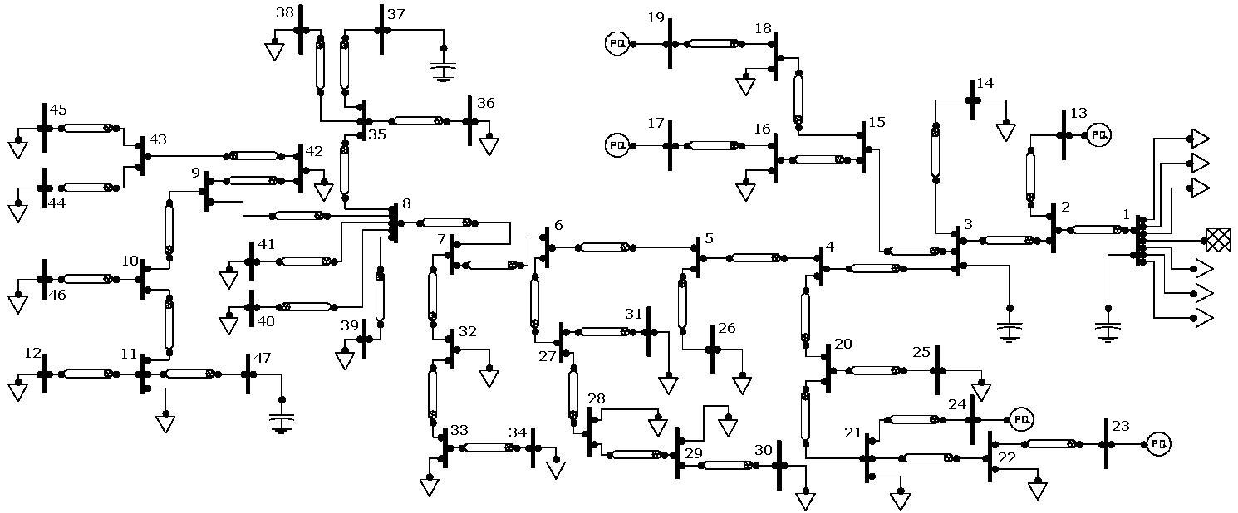
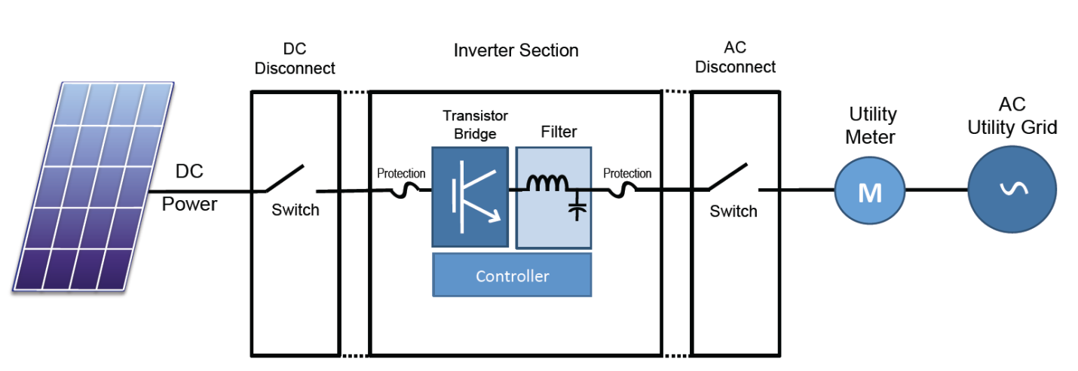
Application: Volt/VAR control
Motivation
Static capacitor control cannot cope with rapid random fluctuations of PVs on distr circuits
Inverter control
Much faster & more frequent
IEEE 1547 does not optimize VAR currently (unity PF)

Slide 83
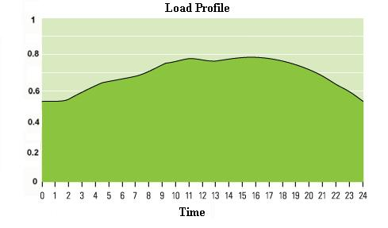
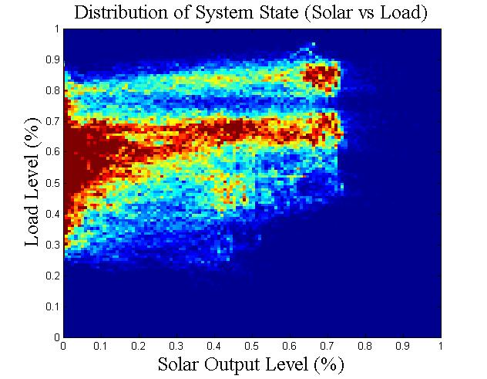
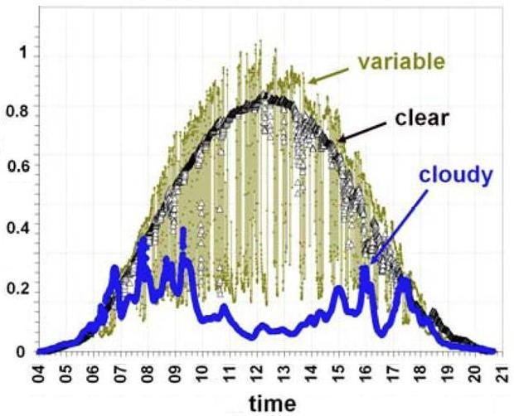
Load and Solar Variation
Empirical distribution
of (load, solar) for Calabash

Slide 84
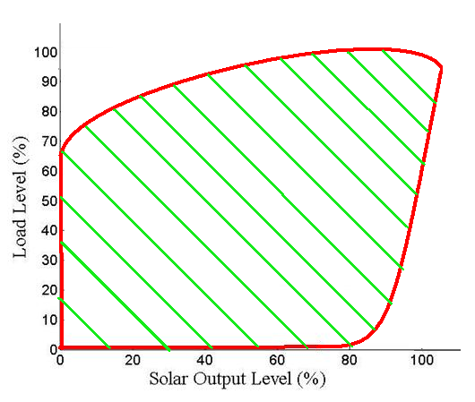
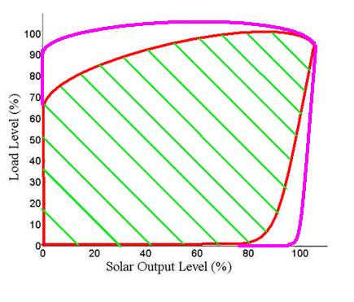
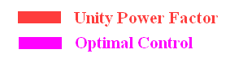
Improved reliability
for which problem is feasible
Implication: reduced likelihood of violating voltage limits or VAR flow constraints

Slide 85
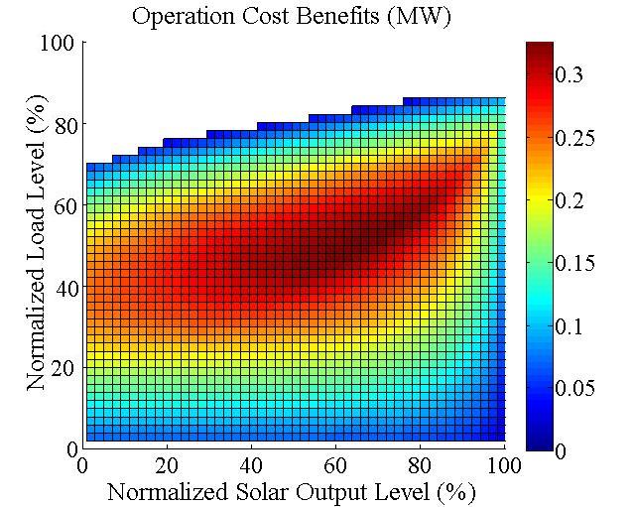
Energy savings

Slide 86
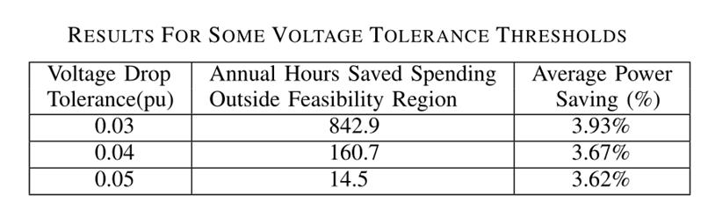
Summary
More reliable operation
Energy savings

